Slide 1





EMOSIC
EMOTION BASED MUSIC PLAYER
Guided by :
Prof. Nisy John Panicker
Presented by :
Aswin Animon (AIK19CS020)
Antony A Chirayath (AIK19CS015)
Aravind S Menon (AIK19CS017)
Arun Prasad M (AIK19CS019)
01

Slide 2


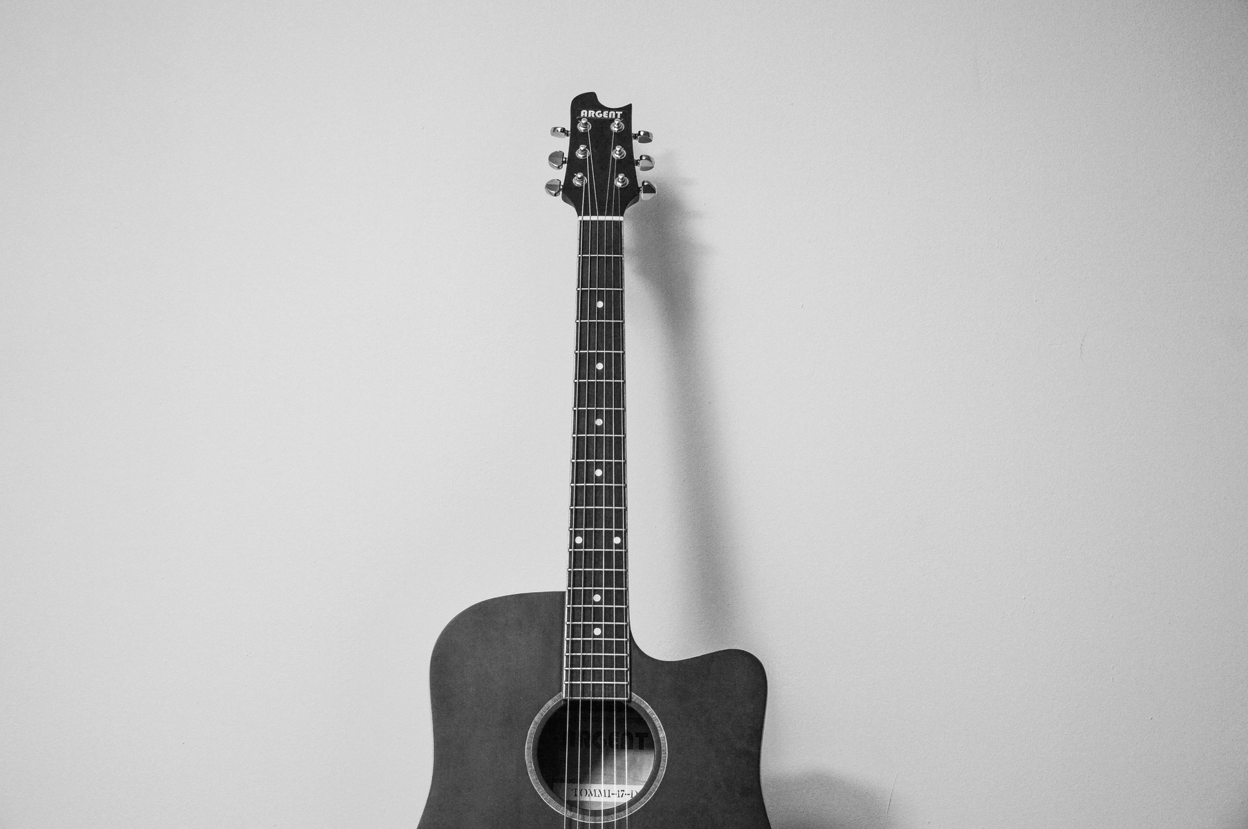


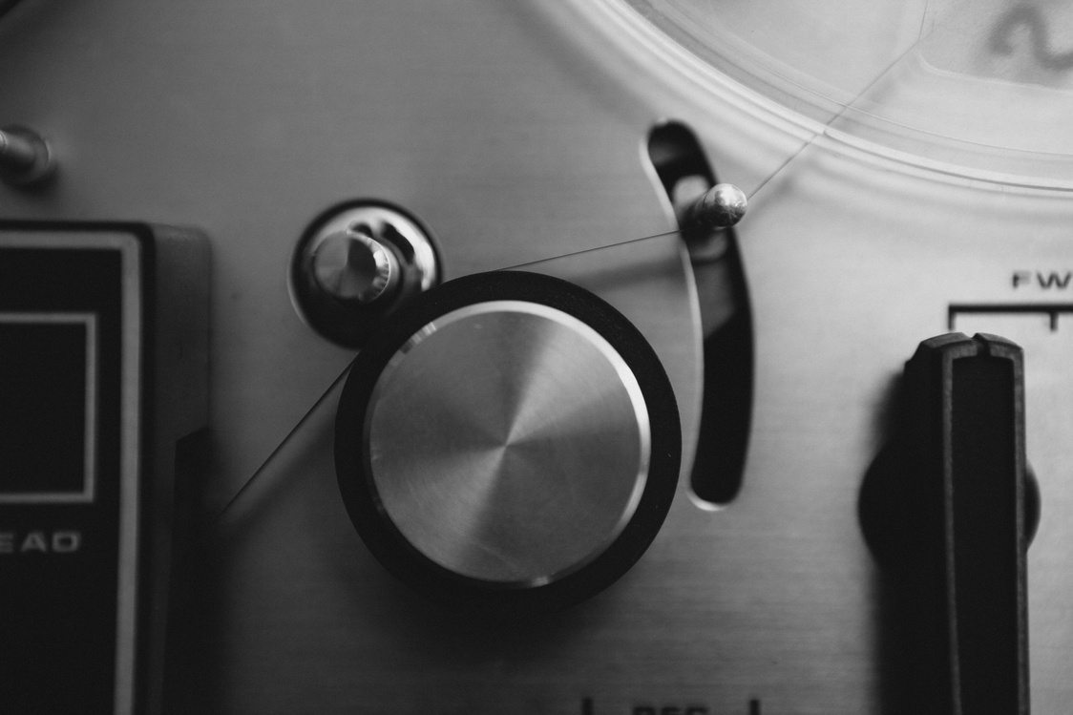
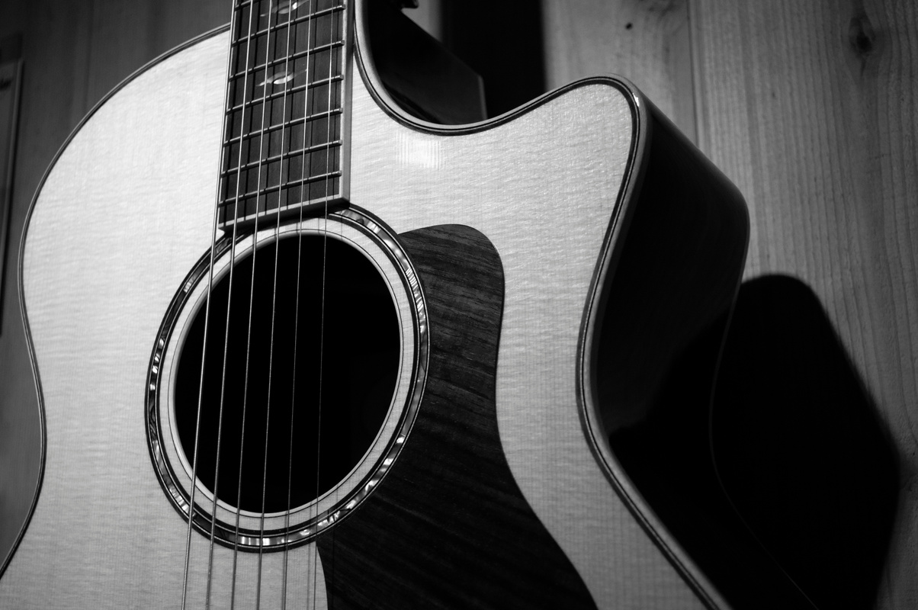
TABLE OF CONTENTS
INTRODUCTION
PROBLEM STATEMENT
RELEVANCE
EXISTING SYSTEM
PROPOSED SYSTEM
DESIGN
IMPLEMENTATION
PROJECT SCREENSHOTS
TESTING
PO/PSO MAPPING
TASK DISTRIBUTION
FUTURE SCOPE
CONCLUSION
REFERENCE
02

Slide 3


INTRODUCTION
Face recognition technology has widely attracted attention due to its enormous application value and market potential. It is being implemented in various fields like security systems, digital video processing, and many such technological advances.
Additionally, music is a form of art known to have a greater connection with a person’s emotions. It has got a unique ability to lift up one’s mood.
Relatively, we focus on building an efficient music recommendation system that determines the emotion of users using facial recognition techniques.
Moreover, on a larger dimension, this would render salvage of time and labor invested in performing the process manually.
The overall concept of the system is to recognize facial emotions and recommend songs efficiently. The proposed system will be both time and cost-efficient.
03

Slide 4




PROBLEM
STATEMENT
It's often confusing for a person to decide what music they want to listen. It depends upon the mood of the person listening. Our emotions determine our mood, and that is what we are trying to bring forth.
Our project is to develop an Emotion Based Music Player/ Recommendation System, which is a web application meant for users to minimize their efforts in managing large playlists and to recommend songs based on the user’s mood.
The proposed model will extract the user's facial expressions and features to determine the current mood of the user.
Once the emotion is detected, random songs suitable to the mood from the dedicated playlist will be presented to the user.
04

Slide 5
RELEVANCE
Making a choice about what music to listen to can be difficult. It depends on how the listener is feeling. We are attempting to emphasize the fact that our emotions dictate our mood. One's own facial expressions are used to choose what music to recommend. There's a chance that the number of music in one's library might be too large and it will be difficult to decide or figure out what music they want to play.
So, here we propose a music recommendation system/music player that helps the user decide what music to listen to and play. The best tunes for the user's mood are provided by this system, saving the user time spent searching for music. Appropriate music from the playlist is played when the user's image is captured using a camera and the facial expression is examined.
05

Slide 6


EXISTING
SYSTEM
Like most music players or streaming apps like Spotify, users must manually select the music they want to listen to. It will rather be a hassle to select music according to the mood when he/she has large playlists of music to choose from.
Here recommendation system is based on the user’s past history rather than their mood/emotion at the instance.
06

Slide 7
PROPOSED SYSTEM
It's often confusing for a person to decide what music they want to listen to. It depends upon the mood of the person listening. Our emotions determine our mood, and that is what we are trying to bring forth.
Music recommendation is based on one's own facial emotions. There's a chance that the number of music in one's library might be too large and it will be difficult to decide or figure out what music they want to play.
So, here we propose a music recommendation system/music player that helps the user decide what music to listen to and play. The user does not have to waste any time looking for songs as this system provides the best tracks for the user's mood. The user's image is taken on a camera and the facial structure is then analyzed and then based on the analysis, an appropriate song from the playlist is recommended and played.
07

Slide 8




DESIGN
08

Slide 9
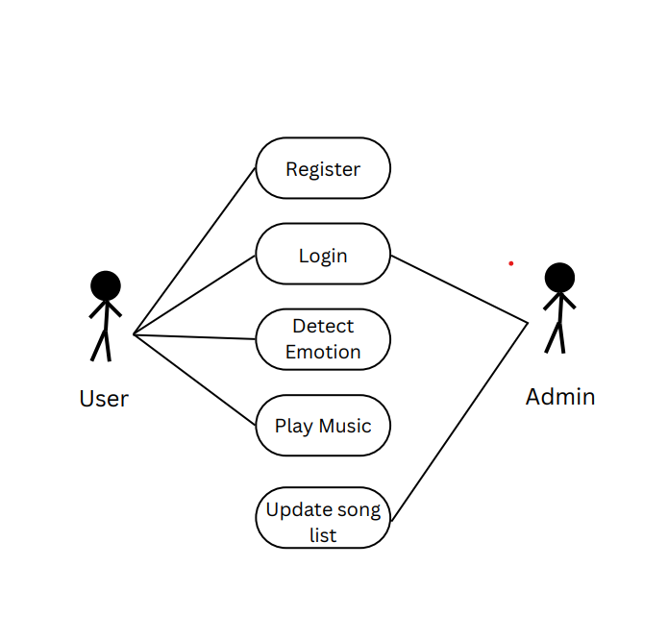
USECASE DIAGRAM
09

Slide 10
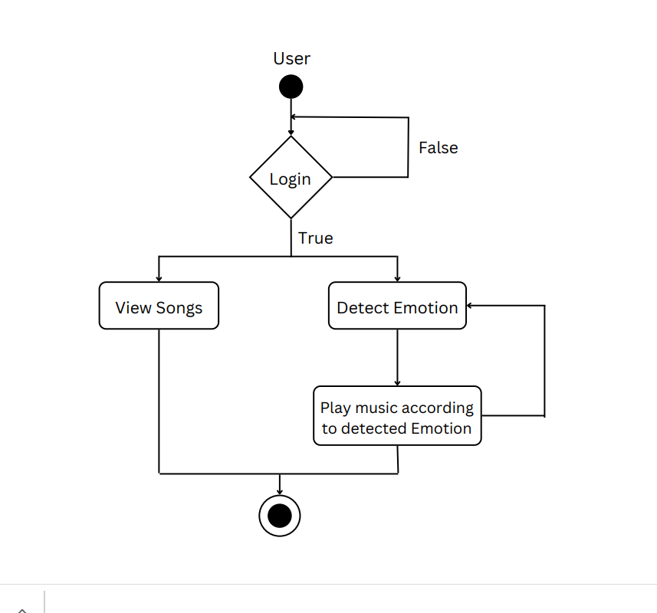
ACTIVITY DIAGRAM
10

Slide 11
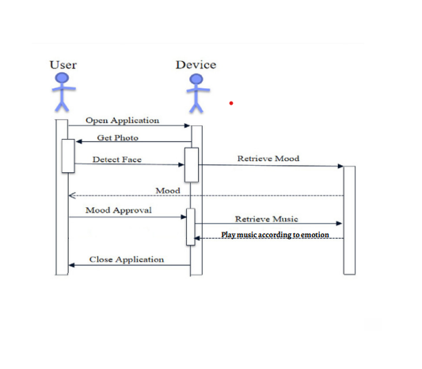
SEQUENCE DIAGRAM
11

Slide 12
IMPLEMENTATION
12

Slide 13
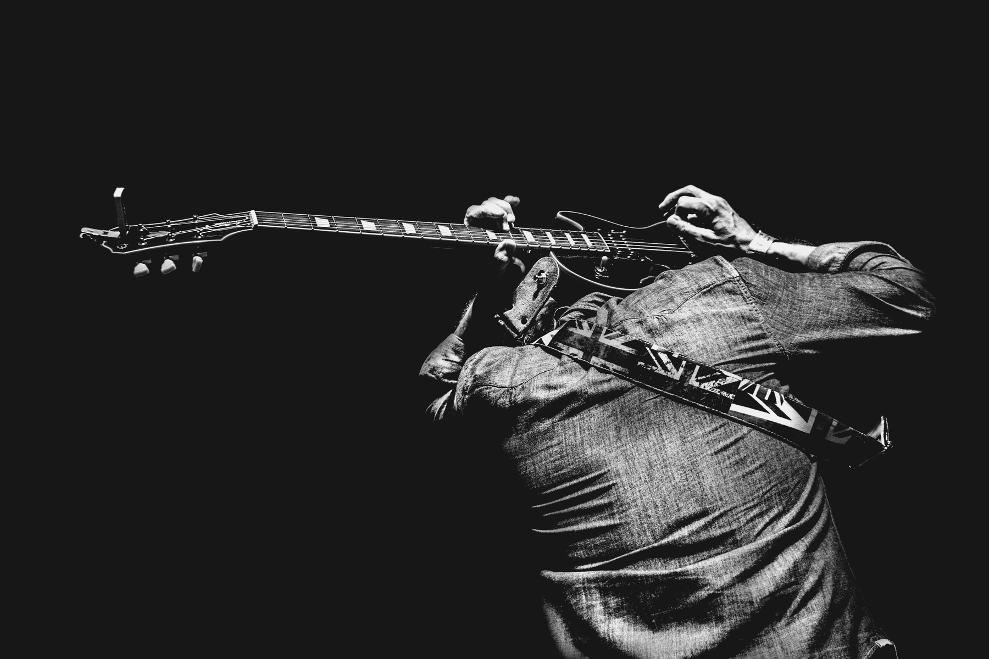
HARDWARE
REQUIREMENT
Intel i5 or Ryzen 5
8gb ram
Web cam
SOFTWARE
REQUIREMENT
Any browser that supports HTML5 like Chrome, firefox, opera, etc
13

Slide 14
pip install opencv-contrib-python
Haar Cascade Frontalface Algorithm
Haar cascade is an algorithm that can detect objects in images, irrespective of their scale in image and location. Here, it is used for the detection of faces.
Simple Convolution Neural Network
A CNN is a kind of network architecture for deep learning algorithms and is specifically used for image recognition and tasks involving pixel data processing. Here, we have trained the simple CNN with the FER-2013 dataset. for recognizing 7 different emotions.
Basic Working
Essentially, how the EMOSIC works is that it runs off a website that hosts the music player, then it sends a request through the backend and calls the emotion detection function. From there a window with webcam access will pop up for the detection and it will first try to locate the person's face by utilizing the Haar Cascade Frontalface machine learning algorithm, then classify it using a trained CNN. The CNN was trained with the FER-2013 dataset. for recognizing 7 different emotions. Depending on the detected mood, the music player will then recommend an appropriate song to play.
14

Slide 15
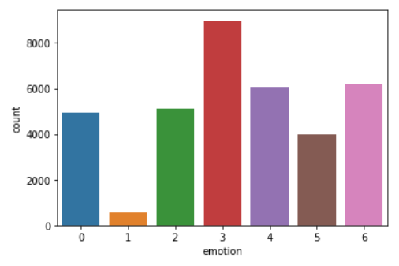
DATASET
FER 2013
The FER-2013 database has seven facial expression categories (e.g., angry, disgust, fear, happy, sad, surprise, and neutral) and three different sets such as a training set (28.709 images), validation set (3.589 images), and test set (3.589 images).
0-Anger
1-Disgust
2-Fear
3-Happiness
4-Sadness
5-Surprise
6-Neutral
15

Slide 16
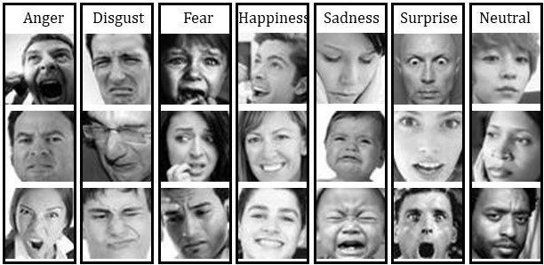
16

Slide 17
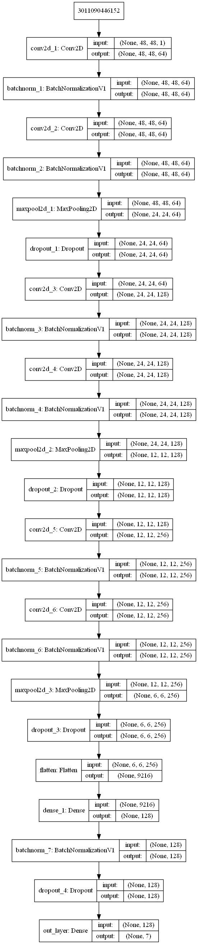
ARCHITECTURE
17

Slide 18
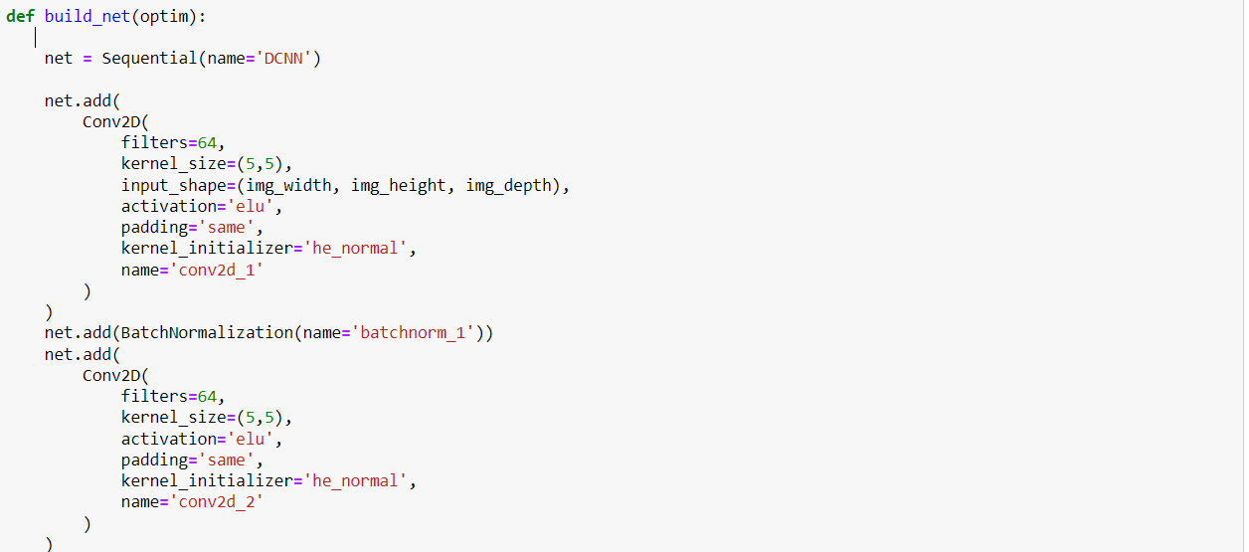
MODEL
18

Slide 19
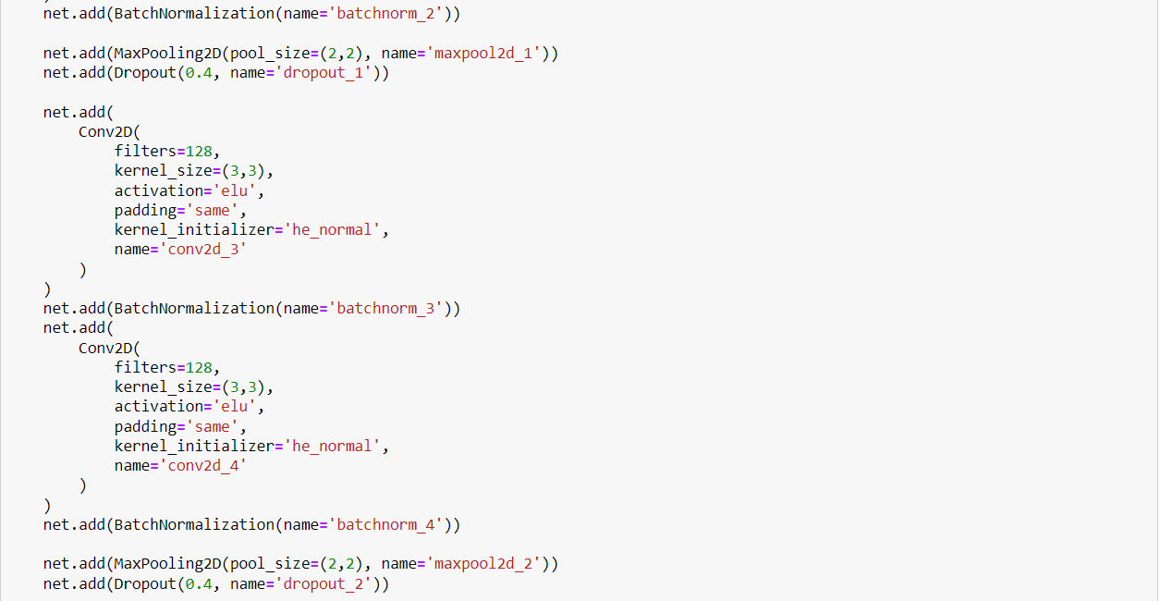
19

Slide 20

20

Slide 21
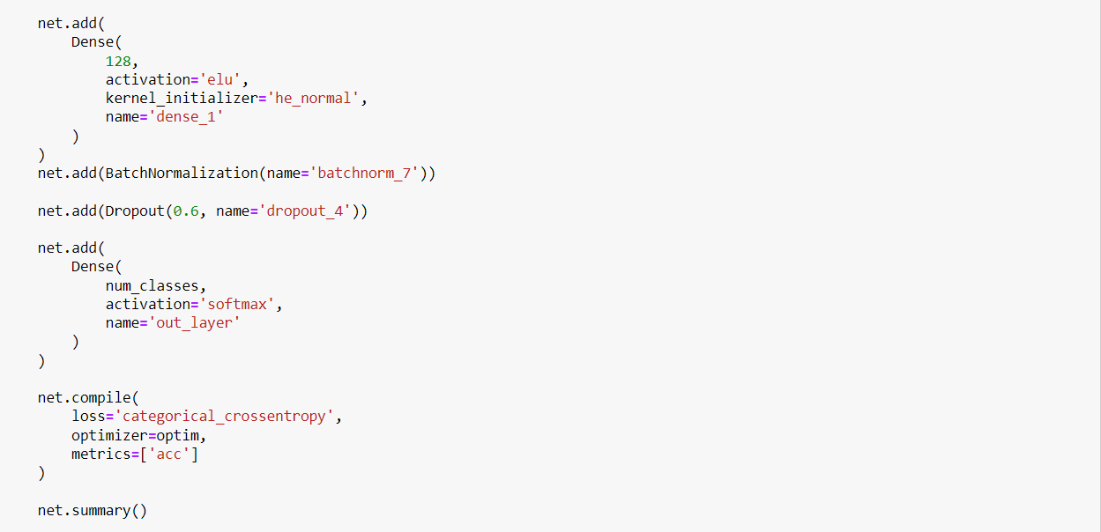
21

Slide 22
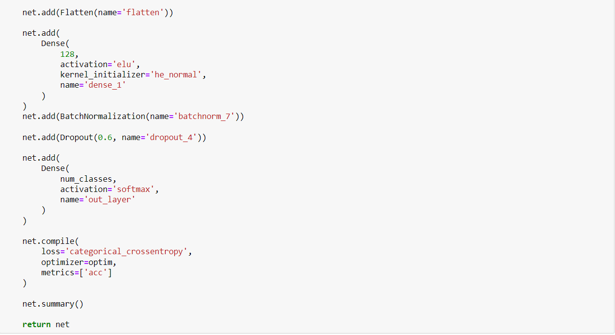
22

Slide 23
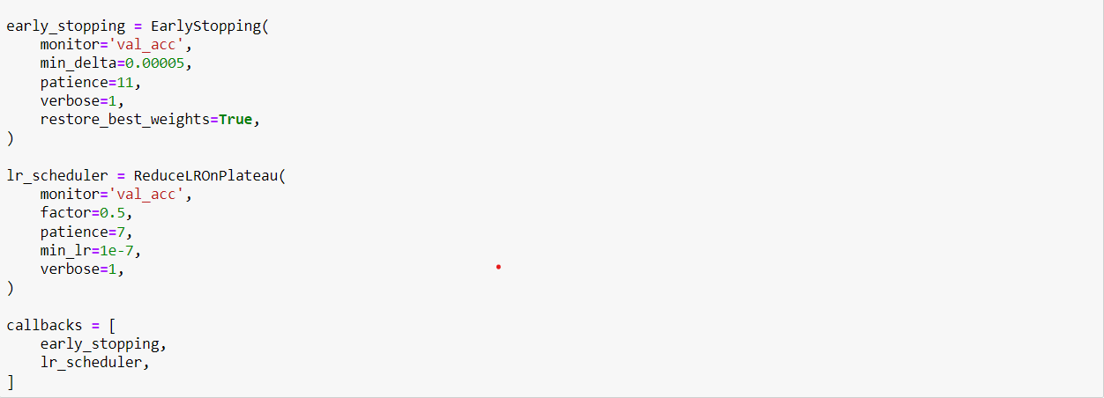
23

Slide 24
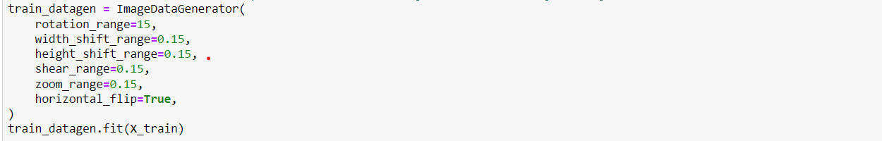
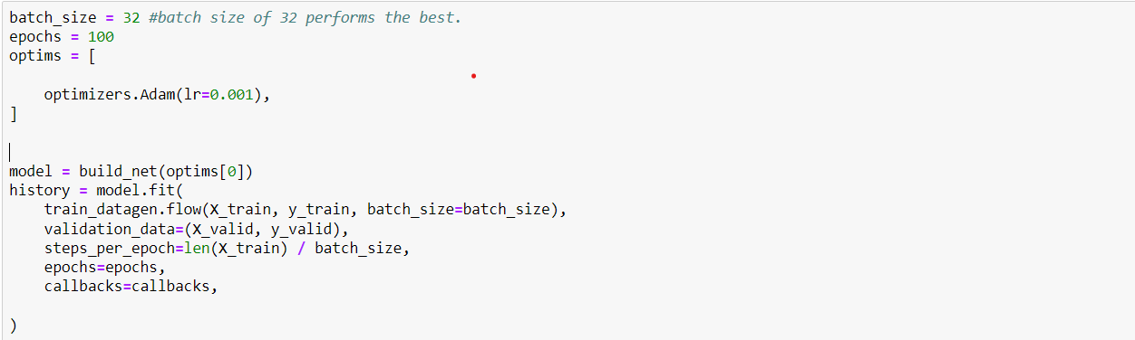
24

Slide 25
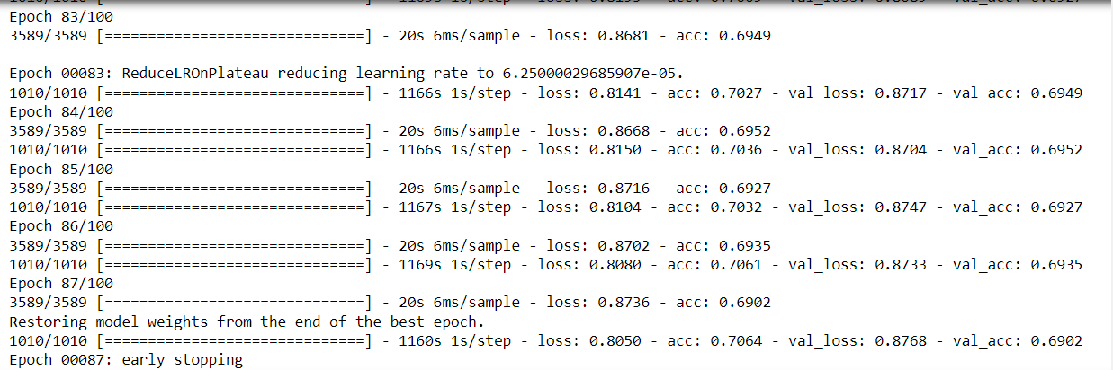
25

Slide 26
PROJECT
SCREENSHOTS
26

Slide 27
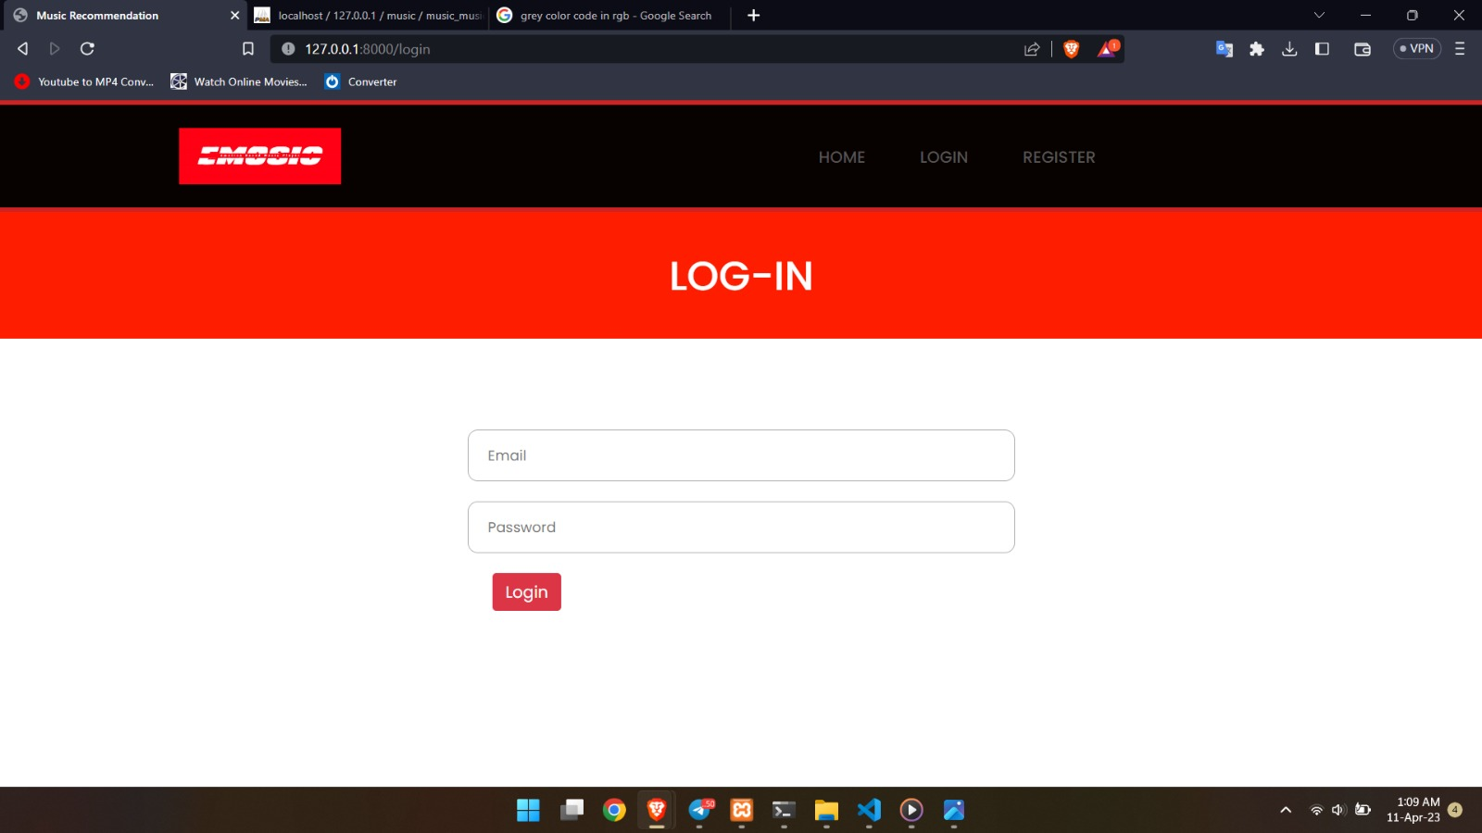
27

Slide 28
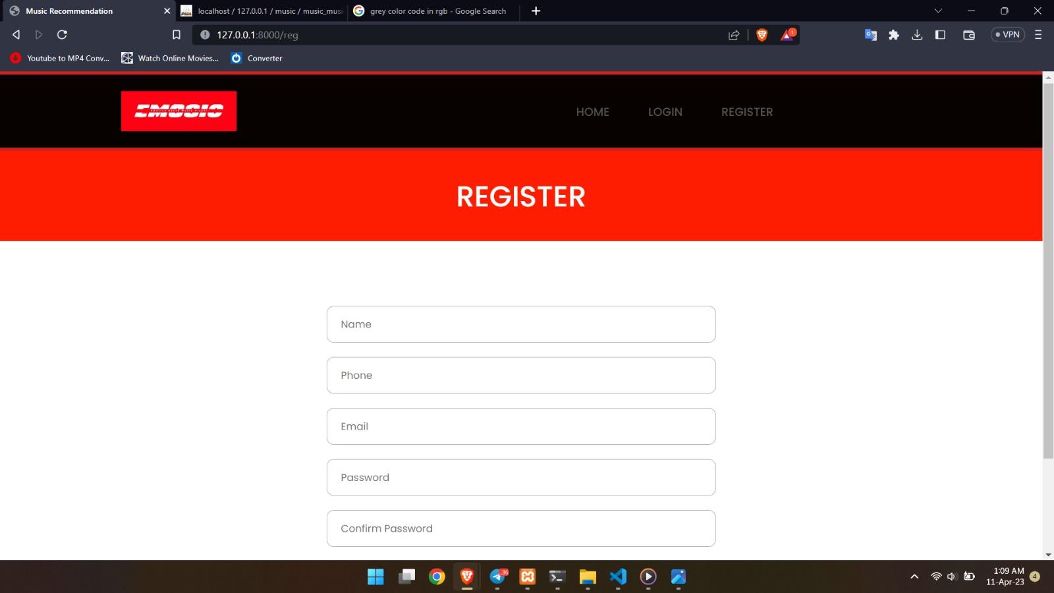
28

Slide 29
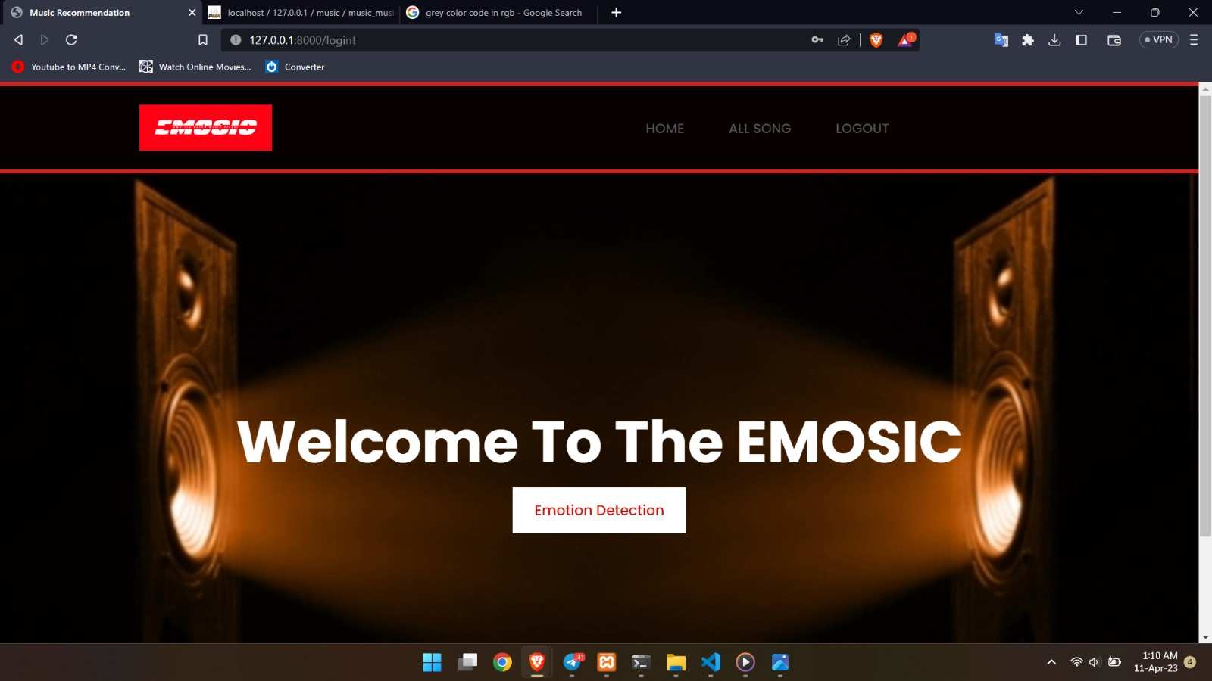
29

Slide 30
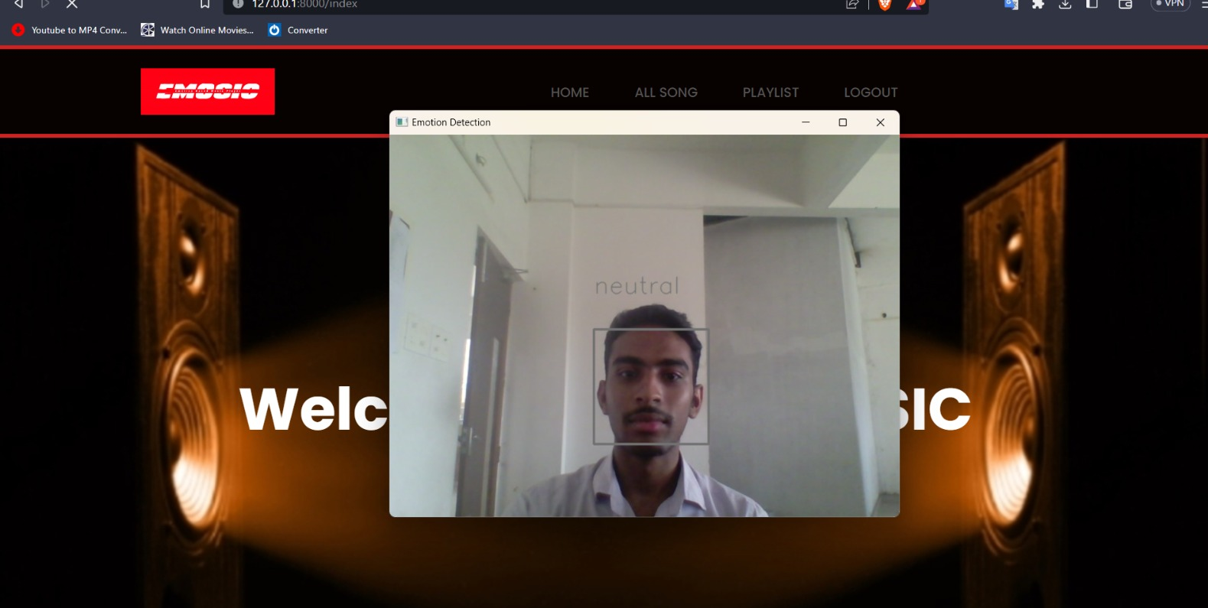
30

Slide 31
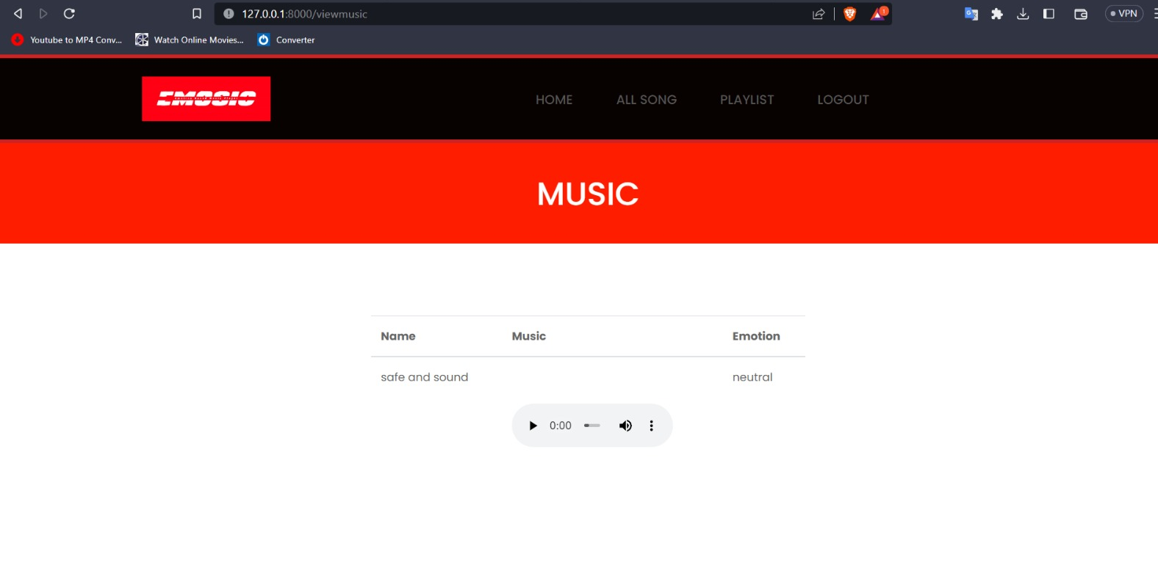
31

Slide 32
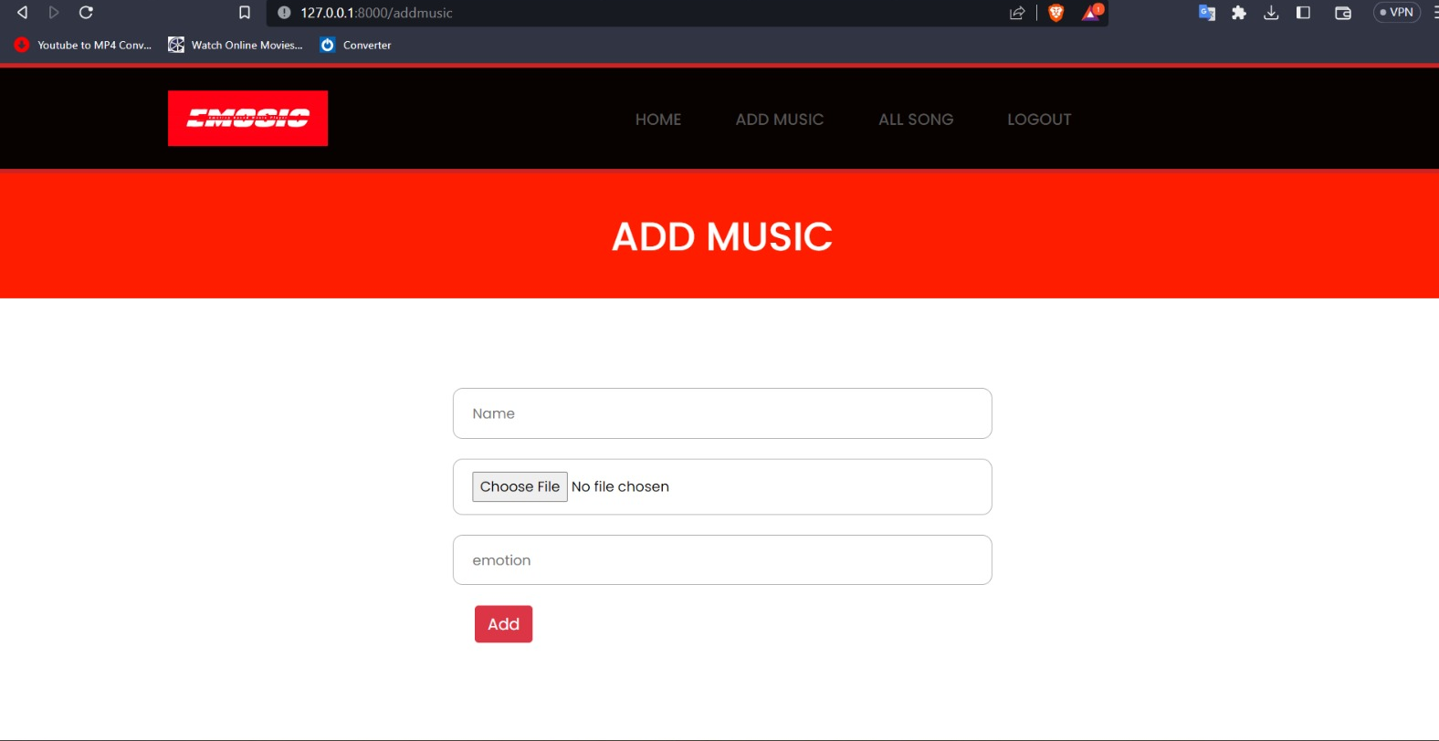
32

Slide 33
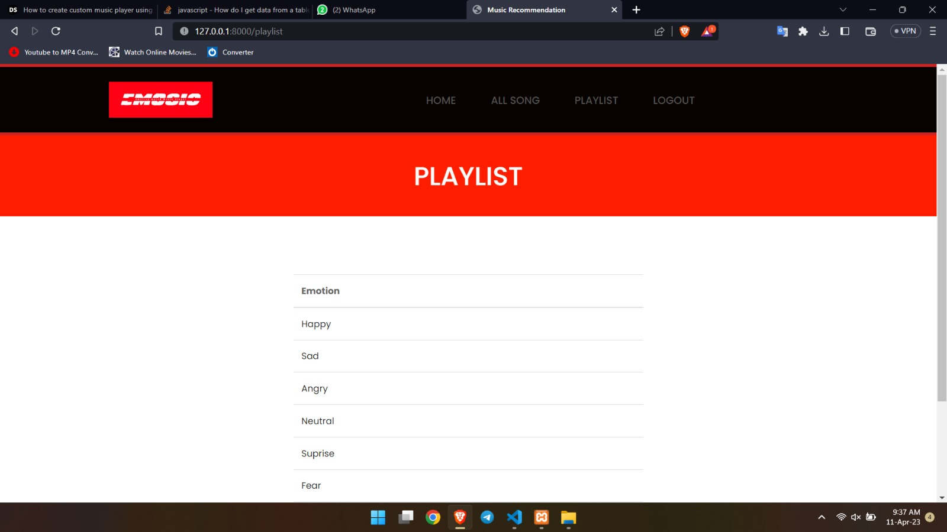
33

Slide 34
TESTING
34

Slide 35
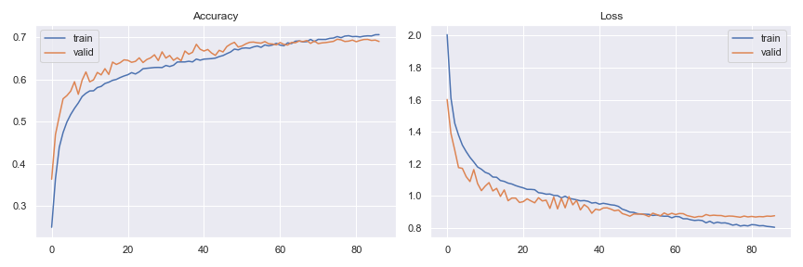
ACCURACY
Epochs | Accuracy | Val_accuracy
10 | 0.6180 | 0.6180
20 | 0.6467 | 0.6467
30 | 0.6656 | 0.6656
40 | 0.6459 | 0.6718
50 | 0.6703 | 0.6771
60 | 0.6859 | 0.6821
70 | 0.6899 | 0.6913
80 | 0.7016 | 0.6935
86 | 0.7064 | 0.6902
35

Slide 36
LOSS
Epochs | Loss | Val_loss
10 | 1.1665 | 1.0332
20 | 1.0579 | 0.9596
30 | 1.0028 | 0.9195
40 | 0.9589 | 0.9182
50 | 0.8980 | 0.8875
60 | 0.8641 | 0.8921
70 | 0.8425 | 0.8774
80 | 0.8135 | 0.8696
86 | 0.8050 | 0.8768
36

Slide 37
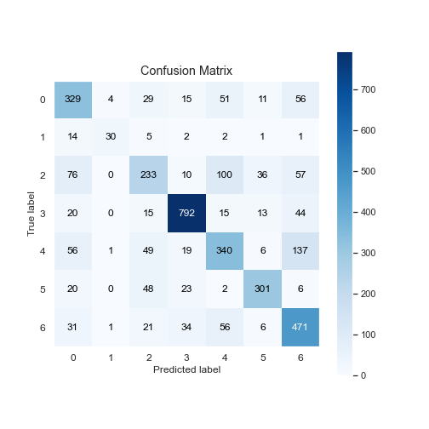
CONFUSION MATRIX
 | Precision | Recall | f1-score | Support
0 | 0.60 | 0.66 | 0.63 | 495
1 | 0.83 | 0.55 | 0.66 | 55
2 | 0.58 | 0.46 | 0.51 | 512
3 | 0.88 | 0.88 | 0.88 | 899
4 | 0.60 | 0.56 | 0.58 | 608
5 | 0.80 | 0.75 | 0.78 | 400
6 | 0.61 | 0.76 | 0.68 | 620
Avg/total | 0.70 | 0.70 | 0.69 | 3589
0-Anger
1-Disgust
2-Fear
3-Happiness
4-Sadness
5-Surprise
6-Neutral
37

Slide 38
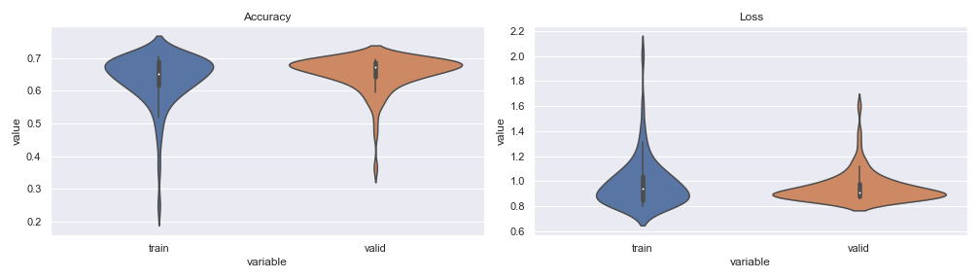
VIOLIN GRAPH
38

Slide 39
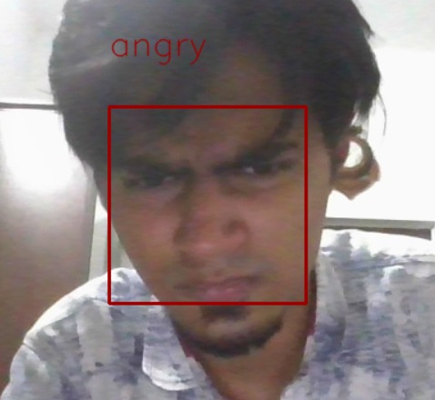
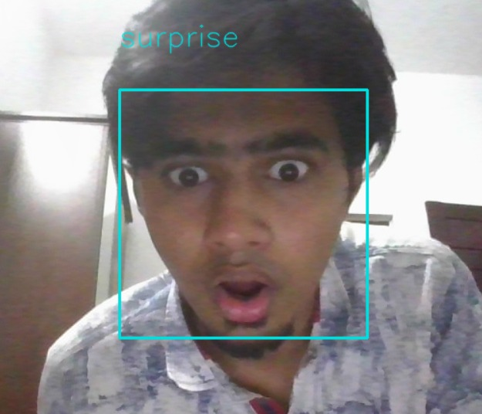
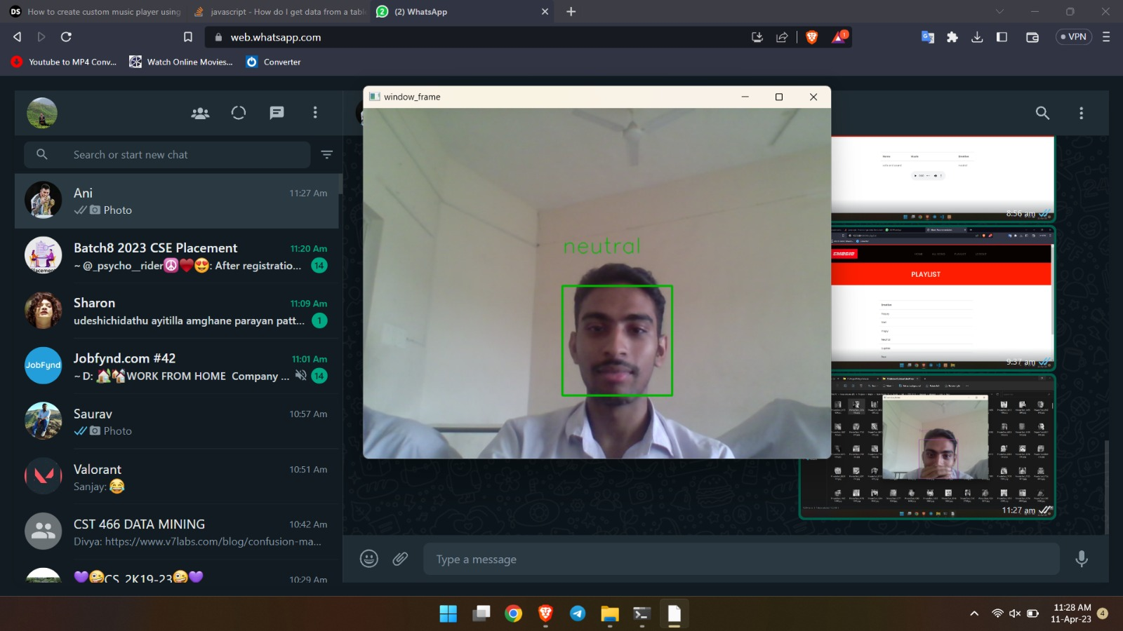
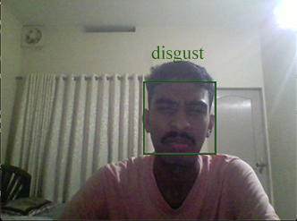
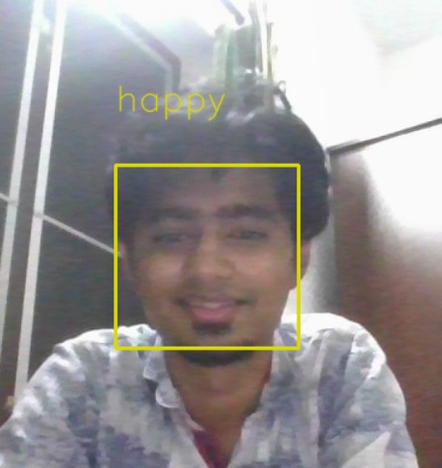
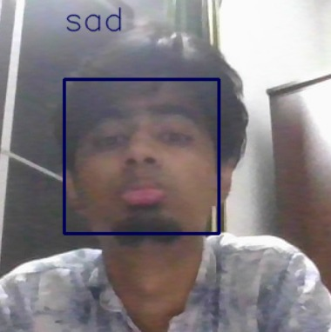
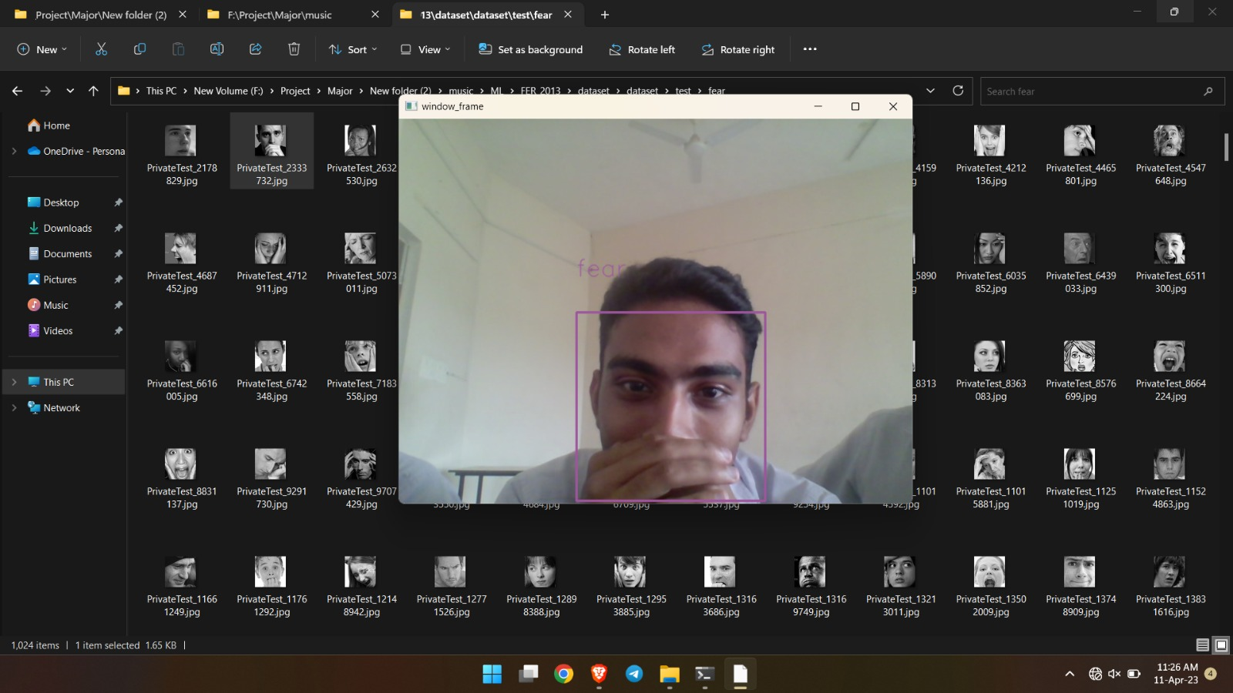
39

Slide 40
PO/PSO
MAPPING
40

Slide 41
EMOSIC - EMOTION-BASED MUSIC PLAYER
P0/PSO MAPPINGS: PO1,PO2,PO3,PO4,PO5,PO8,PO9,PO10,P011,PO12,PSO1,PS02
PO | JUSTIFICATION STATEMENT
PO1: Engineering Knowledge | Will be able to gain knowledge about the engineering fundamentals and engineering specialization by solving all the problems that rise during the completion of the project.
PO2: Problem Analysis | Will be able to review and research about the literatures that is based on the project and analyze the problem and find sustainable conclusions to it.
PO3: Design /development of solutions | Will be able to identify the problem and design and develop solutions that will improve the users wellbeing.
PO4: Conduct investigation on complex problem | Will be able look into the problem that arise in the progression of the project and investigate on it to find the best possible solution for getting most valid and accurate results.
41

Slide 42
PO5: Modern tool usage | Will be able to understand, learn and implement modern engineering tools like Jupyter Notebook for model creation, VScode for implementing the project and MySQL for management of database .
PO8: Ethics | Will learn about the value of ethics and learn to remain honest about the work that is being done without indulging in malpractice or finding lazy solution for the problems.
PO9: Individual and teamwork | Will be able to grasp the value of teamwork by dividing the work amongst team members and individually completing the works assigned on time.
PO10: Communication | Will be able to learn how to write a solid report on the project from scratch and to give outstanding presentation and to convey the ideas to others through presentation.
PO11: Project Management and finance | Will be able to learn to focus on planning and organizing the project and its resources. This includes formulating the project team, assigning tasks to each members according to their skills and efficiently guiding the team through all phases until project completion.
PO12: Life-long learning | Will be able to pursue improving the project and learn more things along the way taking into consideration of the vast about of potential in the project.
42

Slide 43
PSO1: | Will be able to design and develop a computer-based system that recommends music based on the emotion of a person which is of moderate computational complexity.
PSO2: | Will be able to gather knowledge in order to possess a career in Machine Learning and Data Science
43

Slide 44
TASK DISTRIBUTION
ASWIN ANIMON & ANTONY A CHIRAYATH
⬥ MODEL DEVELOPMENT AND TRAINING/DOCUMENTATION
ARAVIND S MENON & ARUN PRASAD M
⬥ FRONTEND DEVELOPMENT AND DATA COLLECTION
44

Slide 45


FUTURE
SCOPE
We could develop this idea into a mobile application since it has a huge potential and could able to attract more users.
Most of us use applications like YouTube, Facebook, and Instagram to watch videos and much more. With sufficient improvement, we would be able to implement our system to recommend content based on user’s emotions.
Application will be able to capture noise while music is played and enable the music volume to go down if the outside noise goes down a certain threshold and back up when the noise goes down.
45

Slide 46


CONCLUSION
Our Project, EMOSIC, will be able to detect the facial emotion and thereby detect the emotion of the user and will recommend/play the desired music according to the mood of the user.
Thus improving the user’s need to search for songs from the vast playlist he/she has.
This project has huge potential lies ahead and we plan to explore and continue to improve it in the future.
46

Slide 47
REFERENCES
G. Chen, L. Hong, J. Dong, P. Liu, J. Conradt and A. Knoll, "EDDD: Event-Based Drowsiness Driving Detection Through Facial Motion Analysis With Neuromorphic Vision Sensor," in IEEE Sensors Journal, vol. 20, no. 11, pp. 6170-6181, 1 June1, 2020, doi: 10.1109/JSEN.2020.2973049.
P. Yin and L. Zhang, "Image Recommendation Algorithm Based on Deep Learning," in IEEE Access, vol. 8, pp. 132799-132807, 2020, doi: 10.1109/ACCESS.2020.3007353.
H. Wang, D. P. Tobón V., M. S. Hossain and A. E. Saddik, "Deep Learning (DL)-Enabled System for Emotional Big Data," in IEEE Access, vol. 9, pp. 116073-116082, 2021, doi: 10.1109/ACCESS.2021.3103501.
H. Zhang, A. Jolfaei and M. Alazab, "A Face Emotion Recognition Method Using Convolutional Neural Network and Image Edge Computing," in IEEE Access, vol. 7, pp. 159081-159089, 2019, doi: 10.1109/ACCESS.2019.2949741.
K. Chankuptarat, R. Sriwatanaworachai and S. Chotipant, "Emotion-Based Music Player," 2019 5th International Conference on Engineering, Applied Sciences and Technology (ICEAST), Luang Prabang, Laos, 2019, pp. 1-4, doi: 10.1109/ICEAST.2019.8802550.
47

Slide 48
REFERENCES
S. Muhammad, S. Ahmed and D. Naik, "Real Time Emotion Based Music Player Using CNN Architectures," 2021 6th International Conference for Convergence in Technology (I2CT), Maharashtra, India, 2021, pp. 1-5, doi: 10.1109/I2CT51068.2021.9417949.
V. P. Sharma, A. S. Gaded, D. Chaudhary, S. Kumar and S. Sharma, "Emotion-Based Music Recommendation System," 2021 9th International Conference on Reliability, Infocom Technologies and Optimization (Trends and Future Directions) (ICRITO), Noida, India, 2021, pp. 1-5, doi: 10.1109/ICRITO51393.2021.9596276.
48

Slide 49
Thank you
49

